Slide 1
Graduation Project
Elevator Control Software Module
GL Embedded ProCamp
Oleksandr Ivanov
Kharkiv 2021v 201
iv 2021

Slide 2
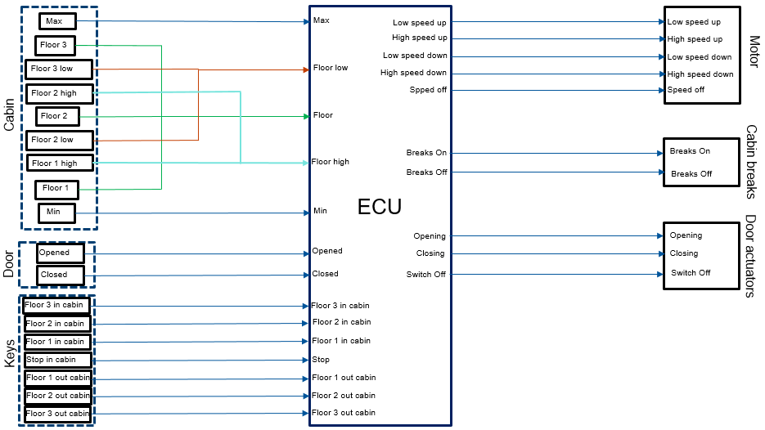
SYSTEM COMPONENTS

Slide 3
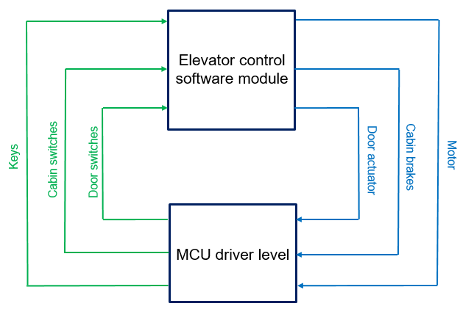
INTERACTION WITH THE DRIVER LEVEL

Slide 4
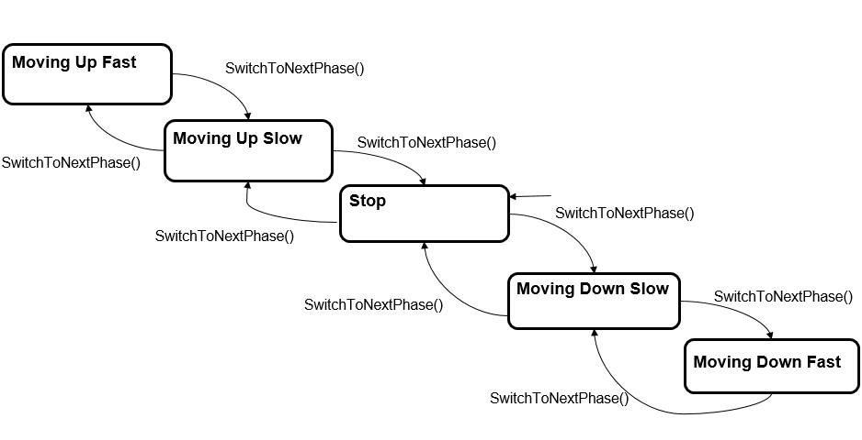
CABIN’S STATE MACHINE

Slide 5
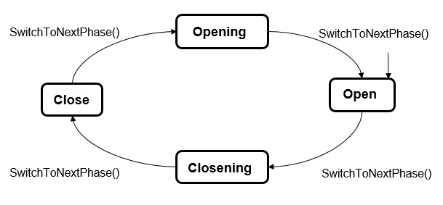
DOOR’S STATE MACHINE

Slide 6
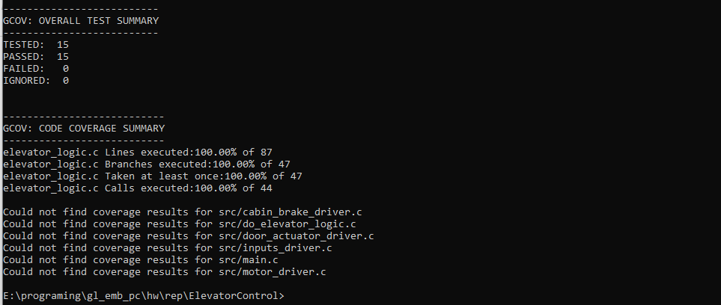
TEST RESULTS

Slide 7
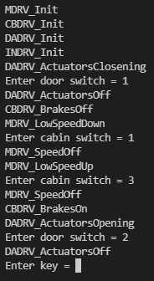
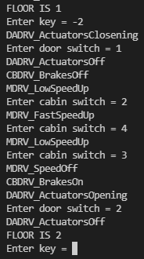
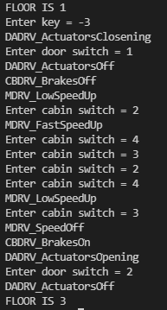
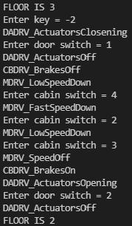
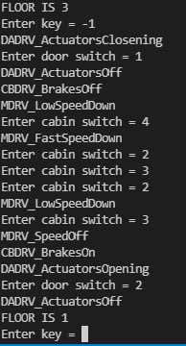
SIMULATION DRIVERS LEVEL WITH SCANF
Power On / Initialization
Moving Up from 1st to 2nd
Moving Up from 1st to 3rd
Moving Down from 3rd to 2nd
Moving Down from 3rd to 2nd

